Slide 1

Online Registration

Slide 2
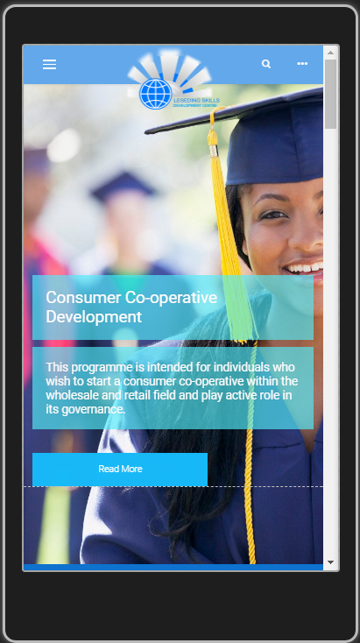

www.lsdc.co.za
Student Portal

Slide 3
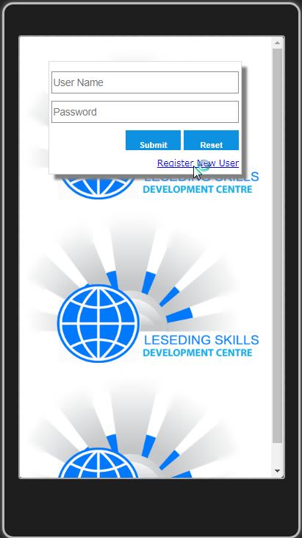
www.lsdc.co.za
Register New User

Slide 4
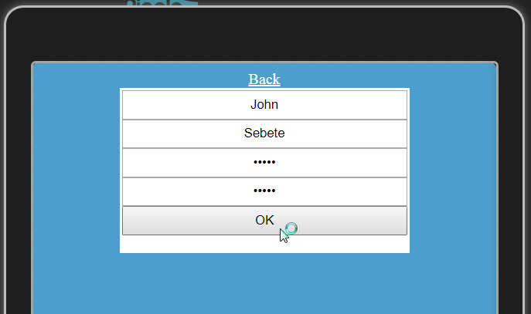
www.lsdc.co.za
Enter User Details

Slide 5

www.lsdc.co.za

Slide 6
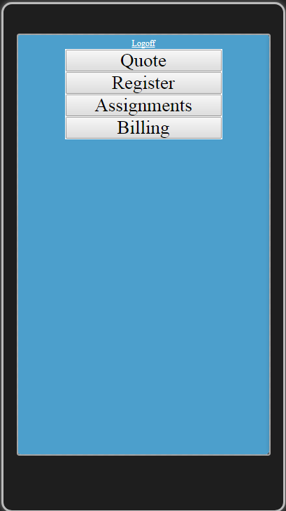
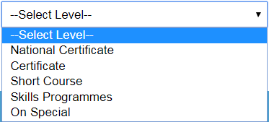
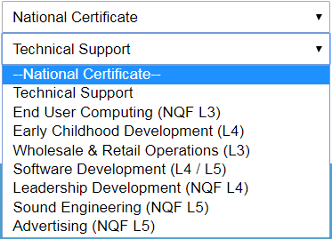
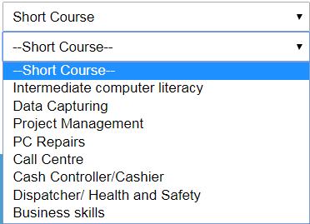
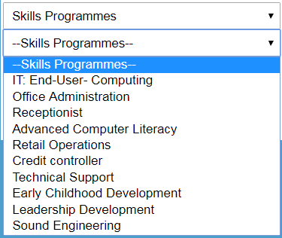
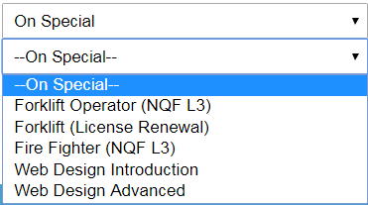
www.lsdc.co.za
quote

Slide 7
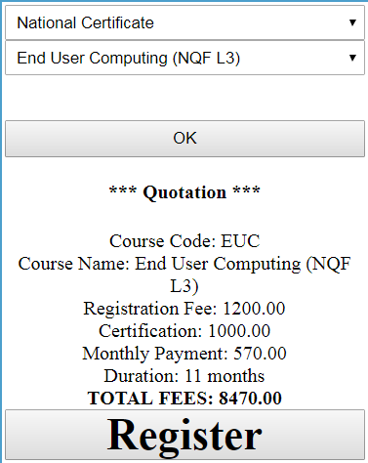
www.lsdc.co.za
registration

Slide 8
online registration discount
GRADUATION CEREMONY FEE
R100 OFF

